Slide 1


Insurance management PROJECT
About
Project
Reference
Final Project – Group 3

Slide 2
About
Project
Reference
100%
100%
100%
HUYNH THANH DUY
TRAN CU PHU
NGUYEN HUU HOAI BAO

Slide 3
About
Project
Reference
100%
100%
LAM TRI THIEN
TRUONG QUANG KHOI

Slide 4

01
INTRODUCTION
About
Project
Reference

Slide 5

About
Project
Reference
The topic of our organization is selling insurance and bonding customer relation by taking individual information and having 1 on 1 take care.

Slide 6
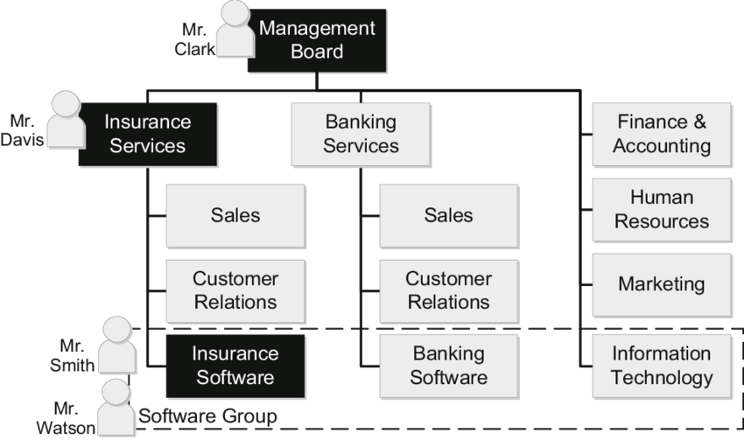
About
Project
Reference
Organization chart
- Objectives:
Customers across the country who needs to use insurance, learn about insurance and associated services.
.

Slide 7
About
Project
Reference
REQUIREMENT 2: Analyze their existing information system

Slide 8
About
Project
Reference
1. Analyze the industry structure and target market share pursued by organization
Market
Competitors
Products and service
Target Market share purused
Geographic Reach

Slide 9
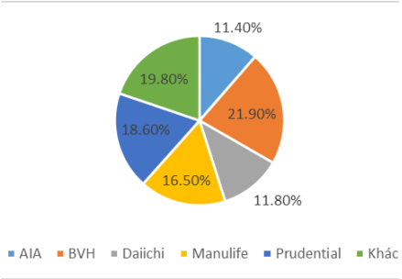
About
Project
Reference
1. Analyze the industry structure and target market share pursued by organization
Life insurance premium collection market share in 2020
The insurance market in Vietnam is mainly in the hands of large companies such as BVH (21.90%), Prudential (18.60%)….

Slide 10
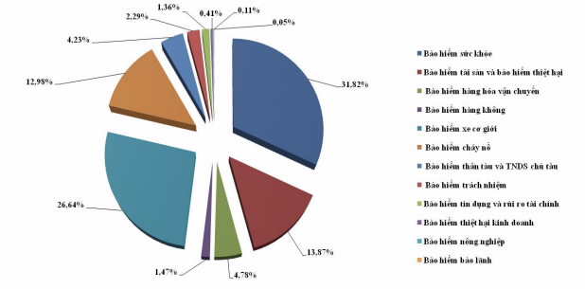
About
Project
Reference
1. Analyze the industry structure and target market share pursued by organization
Proportion of revenue by insurance business in the first 10 months of 2021
Leading in the insurance market is health insurance (31.82%) and motor vehicle insurance (26,64%)

Slide 11
About
Project
Reference
2. Competitive strategy of the organization in each period from the present to the next 10 years
Market
Competitors
Products and service
Target Market share purused
Customer Segments
Market Share Objective

Slide 12
About
Project
Reference
2. Analyzing the business strategy of Baoviet company will aim for 10 years:
Find and increase market share by exploiting target market => Market penetration strategy
Expansion of exploitation to other customers outside the current target market => Market development strategy
Create products that are different from other businesses => Differentiation strategy
Develop product types to limit risks => Diversification strategy

Slide 13
About
Project
Reference
3. Value chain of the system, identify and analyze the main activities/support activities in the value chain that you consider most important:
Underwriting and Risk Assessment
Marketing and Sales
Claims Management
Customer Service
Information Technology (IT)

Slide 14
About
Project
Reference
Primarty activites
Product and service | Marketing and sales | Policy Administration | Claims/Benefits Manager | Asset Manager
+ New products + Product manager + Delivery channels + Research + Prevention and migration | + Promotion + Target Markets + New customers + Cross selling + Up selling | + Transcation Processing + Payment | + Claims Submissions + Claims Settlement + Payment + Fraud | + Portfolio + Managerment + ALM + Risk Analytics
Support activites
+ Data Analytics + Company Infrastructure(Finace, IT, Risk manager) + Reinsurance + Human Resources Management | + Data Analytics + Company Infrastructure(Finace, IT, Risk manager) + Reinsurance + Human Resources Management | + Data Analytics + Company Infrastructure(Finace, IT, Risk manager) + Reinsurance + Human Resources Management | + Data Analytics + Company Infrastructure(Finace, IT, Risk manager) + Reinsurance + Human Resources Management | + Data Analytics + Company Infrastructure(Finace, IT, Risk manager) + Reinsurance + Human Resources Management

Slide 15
About
Project
Reference
4. Analyze organization structure of 5 components of an information system: hardware, software, people, processes, and data.
Hardware
Software
People
Processes
Data

Slide 16
About
Project
Reference
REQUIREMENT 3: Organizational issues and requirements for the new information system

Slide 17
About
Project
Reference
The existing problems of the old insurance system
Inefficient processing of claims
Poor customer service
Lack of integration with other systems
Security vulnerabilities

Slide 18
About
Project
Reference
The expected goals of the new system include
Improved efficiency
Better customer service
Enhanced security
Increased scalability

Slide 19
About
Project
Reference
 | Old Insurance System | New Insurance System
Processes | Reliance on manual processes and paperwork, leading to delays in claims processing, policy issuance, and customer service | Increased automation and streamlined processes for faster operations and improved efficiency
Technology | Outdated technologies and limited access to real-time data analytics, hindering informed decision-making | Integration of advanced technologies and real-time data analytics for better insights and proactive decision-making
Customer Experience | Limited online presence and self-service options resulting in inconvenience and restricted access to services | resulting in inconvenience and restricted access to services resulting in inconvenience and restricted access to services
Security | Vulnerabilities in data security and lack of robust measures for protecting sensitive customer information | Implementation of robust security protocols, encryption, and access controls to ensure data protection
Efficiency | Slow operations and delays in claims processing and policy issuance | Streamlined processes, reduced turnaround times, and improved accuracy through automation
Competitiveness | Limited competitiveness due to outdated systems and processes | Enhanced competitiveness through advanced technology, improved efficiency, and better customer experience
Growth and Innovation | Limited scope for innovation and keeping up with industry trends | Embracing digital transformation, enabling continuous growth and innovation

Slide 20
About
Project
Reference
REQUIREMENT 4: Proposal a new system

Slide 21
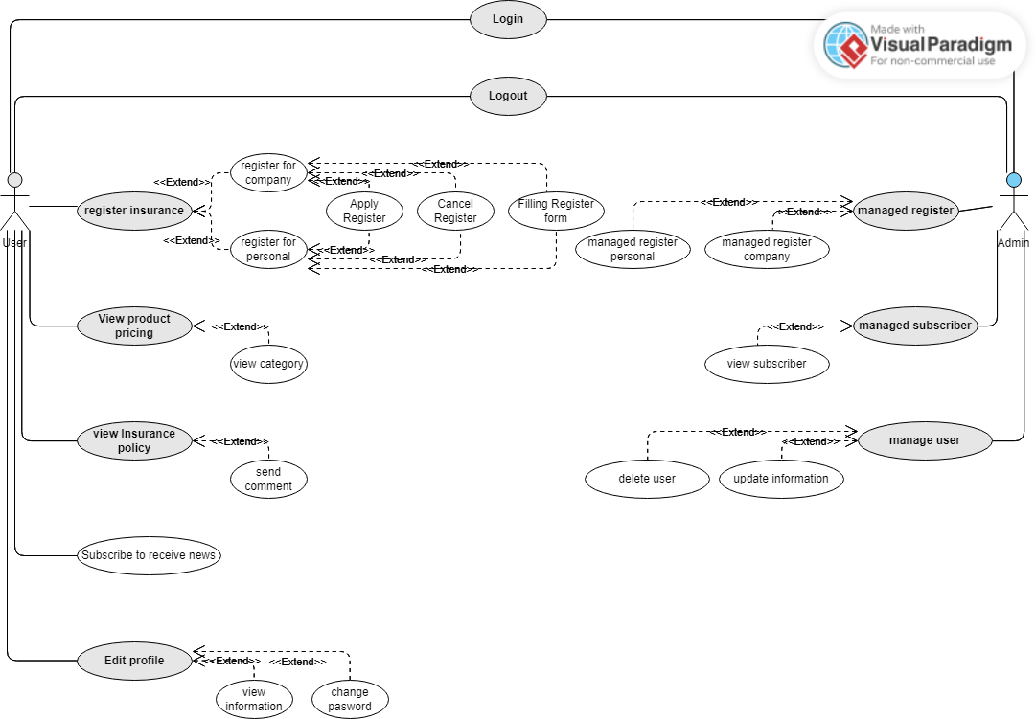
General Usecase diagram

Slide 22
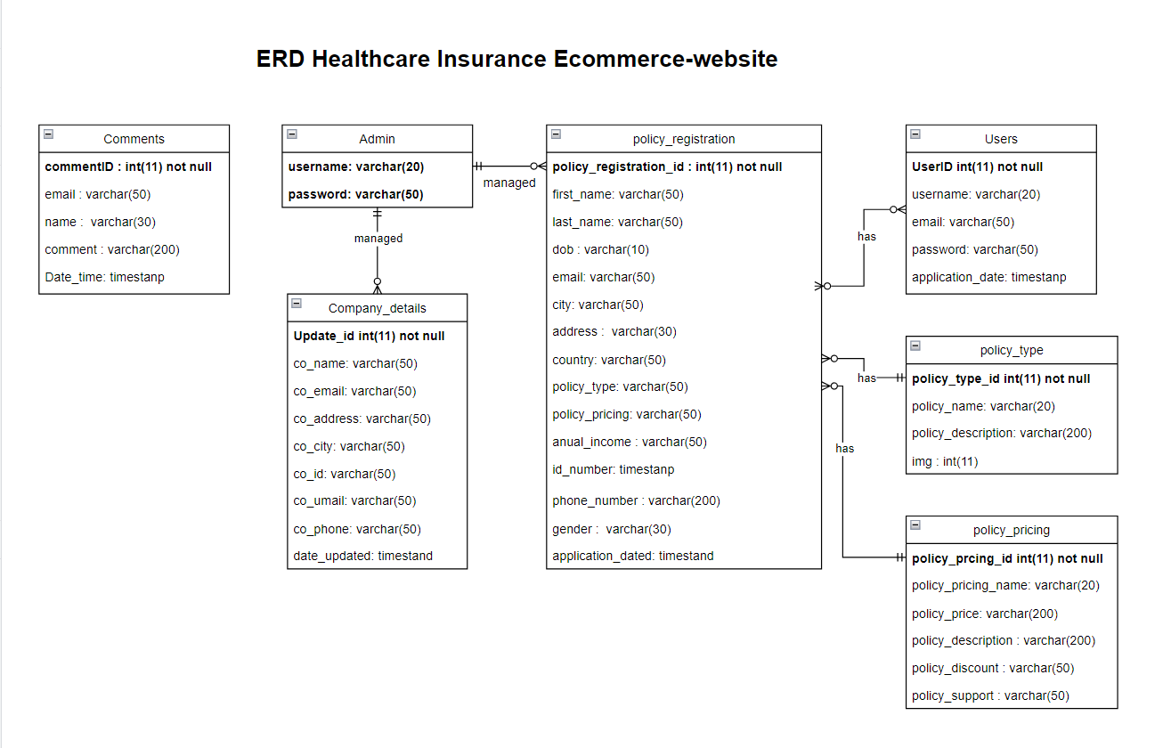
ERD diagram

Slide 23
About
Project
Demo
Analyze and evaluate what new changes/proposals meet/support for the organizations competitive strategy.

Slide 24
About
Project
Reference
- Our organization comeptitive strategy is strengthen customer and supplier intimacy.
- We use information systems to develop strong ties and loyalty with customers and suppliers Increase switching costs by:
Enhance the interaction in E-comerece website by easy-to-see and easy-to-use interface, easy to attract new potential customers.
We get private customer information through website and help user to meet their goal or introduce more suitable product to customer by one-by-one supporting. From this we will develop strong ties and loyalty with customers and suppliers
We making an easy interactive interface for staff to easy tracking customer information, having good customer care and bonding the customer intimacy.

Slide 25
About
Project
Reference
Demo

Slide 26
THANK YOU

